Slide 1

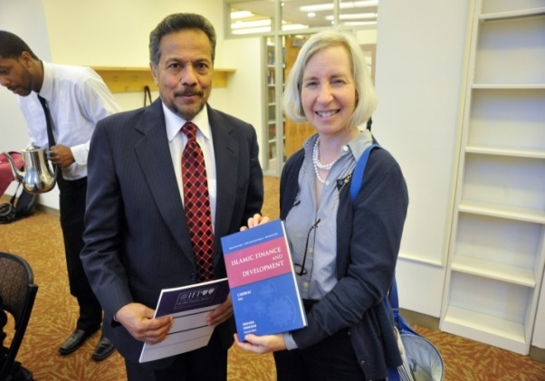
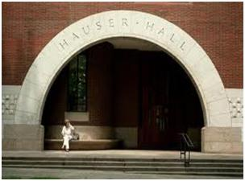


Islamic Finance Project
at Harvard
1995-2014

Slide 2
MISSION
At Harvard Law School, IFP is poised to offer the field of Islamic finance a much needed academic thrust.
It is the only Ivy League project of its kind.
IFP seeks to develop an increased awareness and understanding of Islamic finance both within the Muslim world and in the West.
To this end, it sponsors seminars, lectures, and forums on topics relevant to Islamic finance

Slide 3
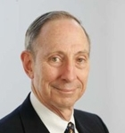
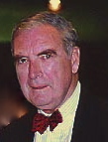
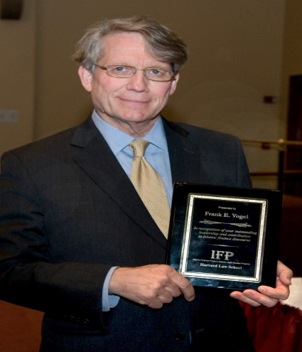
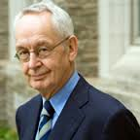
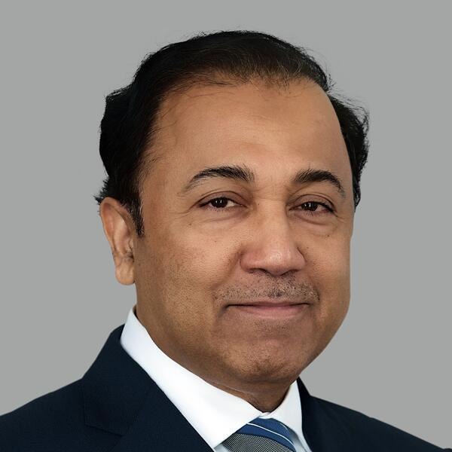


Slide 4
ABOUT IFP
The Islamic Finance Project (IFP) is the continuation of the Harvard Islamic Finance Information Program (HIFIP), which was established at the Center for Middle Eastern Studies in 1995. IFP, now part of the Islamic Legal Studies Program (ILSP) at Harvard Law School, aims to study the field of Islamic Finance from the legal and shari’a points of view by analyzing contemporary scholarship, encouraging collaboration among scholars within and outside the Muslim world, and increasing interaction between theory and practice in Islamic finance.
IFP is interdisciplinary in nature, draws broadly from a variety of fields, and has relationships with professors and students at several university faculties: Harvard Law School, Harvard Business School, Harvard Divinity School, the Harvard School of Government and the Faculty of Arts and Sciences. IFP convenes breakthrough academic forums involving scholars of law, finance, economics, and traditional Islamic ethics and law (fish), engaging leading thinkers in robust, inter- disciplinary dialogue. The Project’s publications add significantly to the academic literature in the field, and its lecture events and seminars have featured top global scholars and professionals.
.

Slide 5
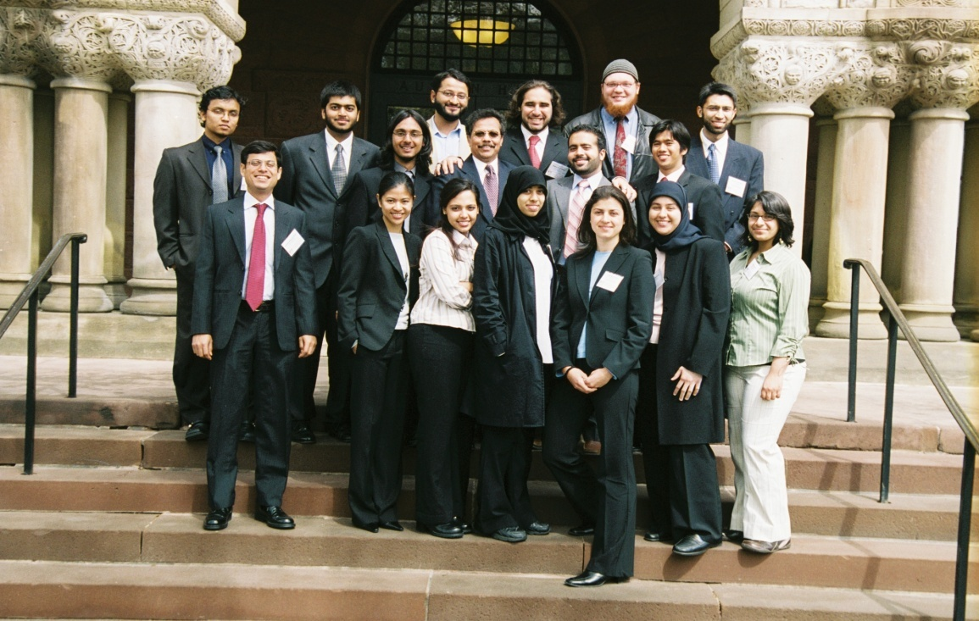
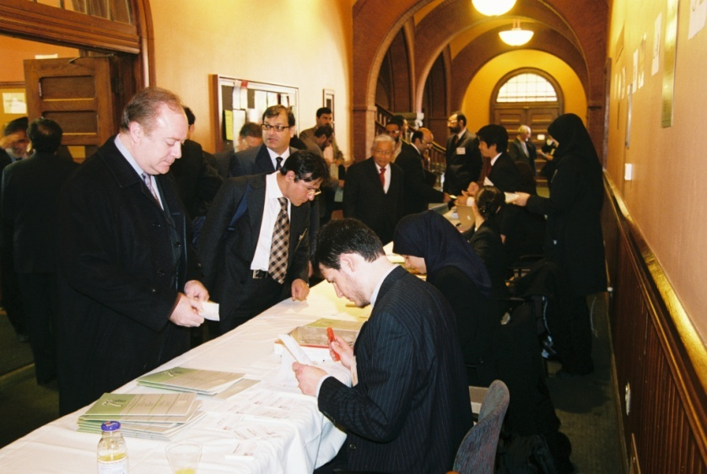
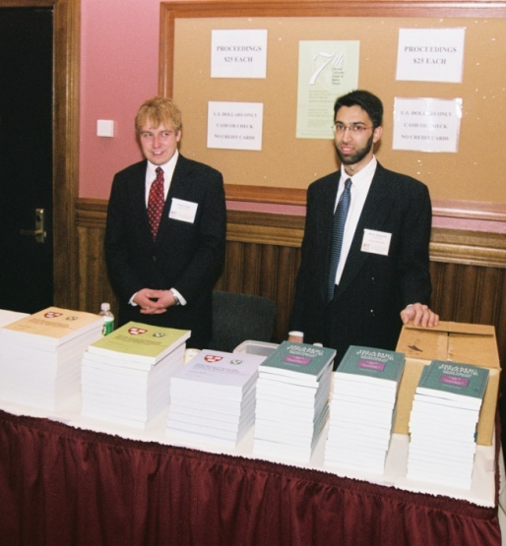
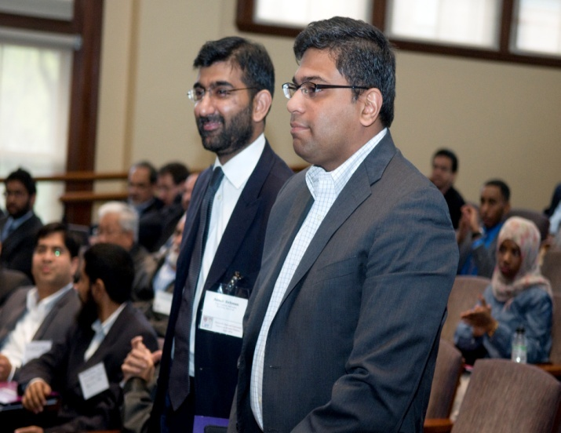
STUDENT INVOLVEMENT
IFP has provided career counseling and helped students procure employment in Islamic finance sector. The Project encourages students to take advantage of its resources, in addition to welcoming their participation in the IFP scholarly community. For many years IFP Forums have been avenues for Harvard students to showcase their talent and scholarship and to forge contacts with sector leaders. Having graduated, many of the associates of the Project went to work for prominent institutions, including several leading financial and consulting firms, both within and outside the Islamic financial sector. Dozens of them are holding prominent positions in the sector and the world.

Slide 6
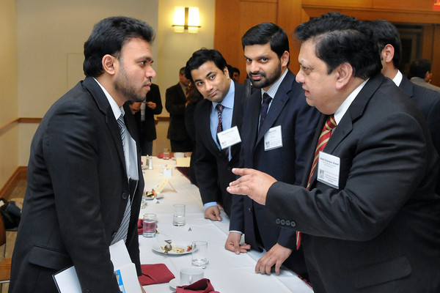
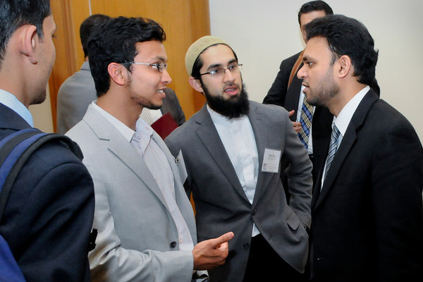
IFP has consistently supported Harvard students in their research endeavors and considers this an important priority. Support includes advising students on their theses/dissertations/term papers.
IFP organizes regular information sessions for members of the Harvard community interested in Islamic banking and finance in general and in the Project in particular. IFP provides researchers in Islamic finance and economics access to its vast store of information.
Researchers throughout the world contact IFP to obtain data and information they need to facilitate their work. Financial professionals also request information from the Project on matters ranging from shari‘a issues to the engineering of financial instruments.
Insert another photo here

Slide 7
HARVARD UNIVERSITY FORUM ON ISLAMIC FINANCE
FP organizes academic events bringing together scholars and experts in law, finance, economics, and Islamic jurisprudence (fiqh), engaging leading thinkers in a robust academic environment.
Harvard Forum has attracted hundreds of notable authors, researchers, and sector experts from across the globe including Nobel Laureates and other very senior and respected scholars.
Over the years the Forum has provided platform to more than 500 scholars from across the globe to share their ideas and research.
Over the years the Forum has fostered a sense of community among researchers, academicians, and sector experts, promoting healthy debate and collaboration among academics, practitioners, and institutions.
So far IFP has hosted 11forums from 1997 to 2014.These fora encourage a holistic approach to exploring the ideas and analyzing the scholarship and exchange of views in a supportive setting free of bias.

Slide 8
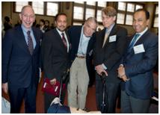
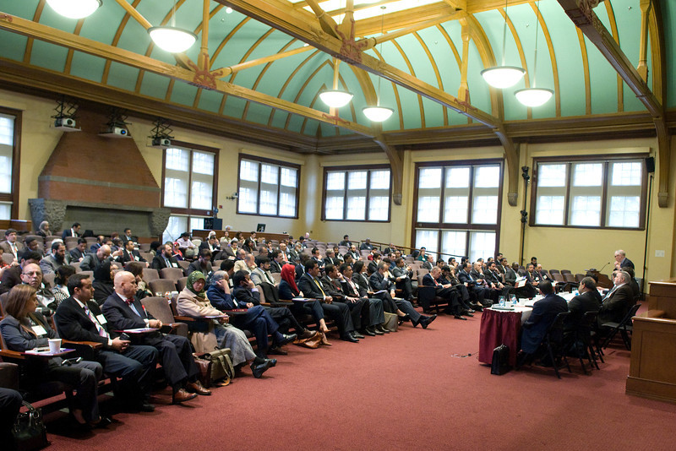
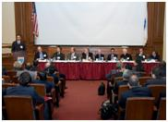
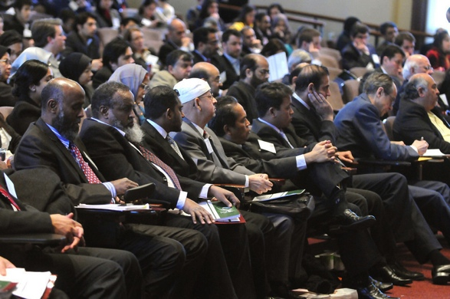
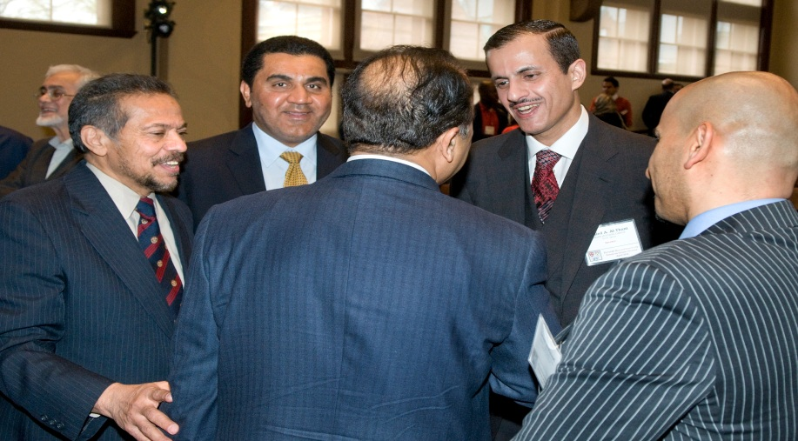

Slide 9
HAVARD FORUMS 1997-2014
11th Forum (2014) Takaful and Alternative Cooperative Finance
10th Forum (2012) Islamic Finance and Development
9th Forum (2010) Building Bridges across Financial Communities
8th Forum (2008) Islamic Finance: Innovation and Authenticity
7th Forum (2006) Integrating Islamic Finance into the Mainstream
6th Forum (2004) Current Legal and Regulatory issues
5th Forum (2002) Islamic Finance: Dynamics and Development
4th Forum (2000) Islamic Finance: The Task Ahead
3rd Forum (1999) Local Challenges, Global Opportunities
2nd Forum (1998) Islamic Finance into the 21st Century
1st Forum (1997) Islamic Finance in the Global Market

Slide 10
IFP COLLABORATION WITH VARIOUS HARVARD FACULTY
Various Harvard Faculty members have participated in the foundation and development of the Islamic Finance Project.
.
A number of Harvard Faculty members have participated in

Slide 11
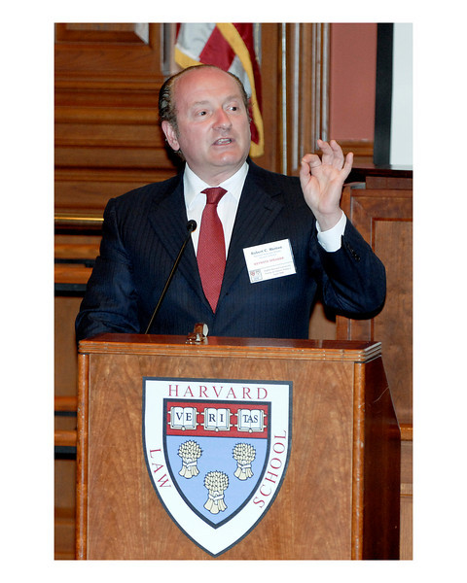
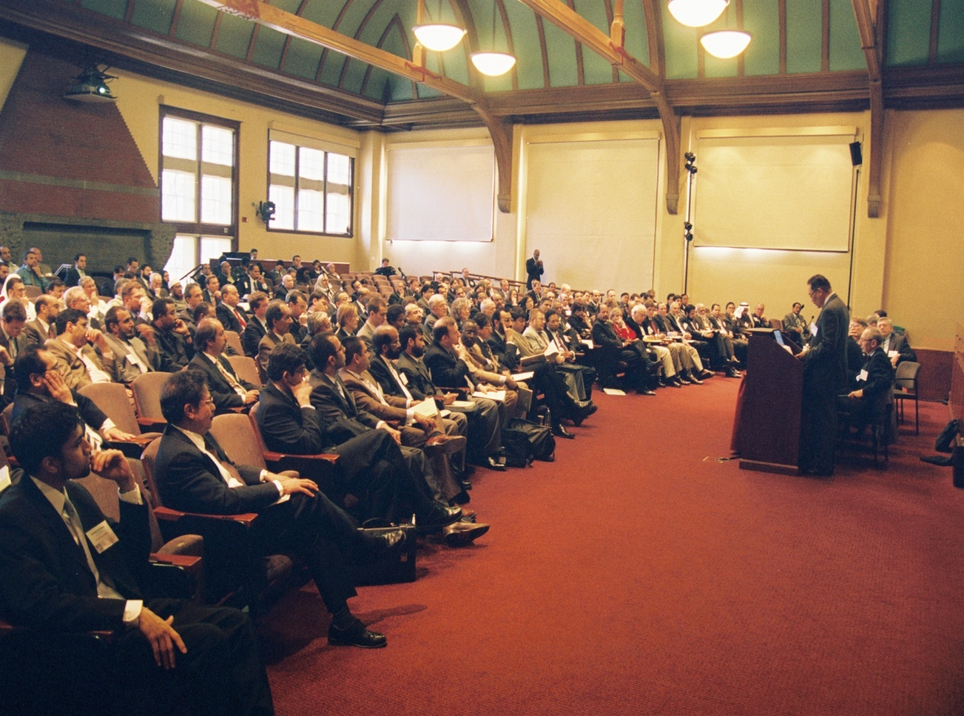
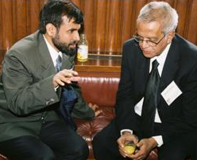
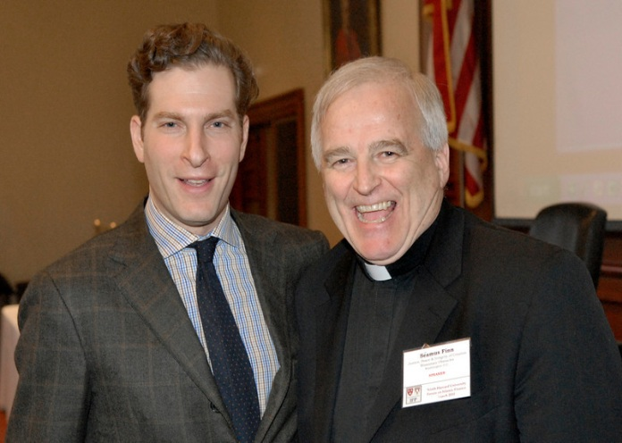
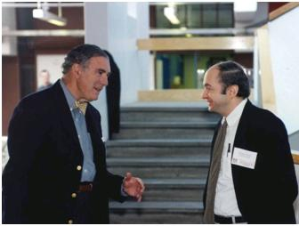

Slide 12
RELIGIOUS AND CULTURAL DIVERSITY
IFP provides the platform for various religious groups to interact on a variety of topics pertaining to finance, economics and social well-being.

Slide 13
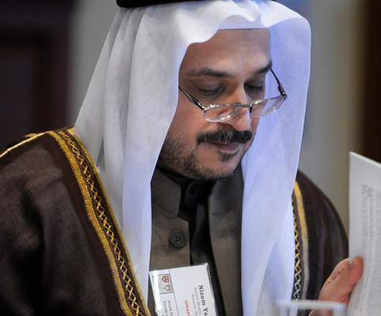
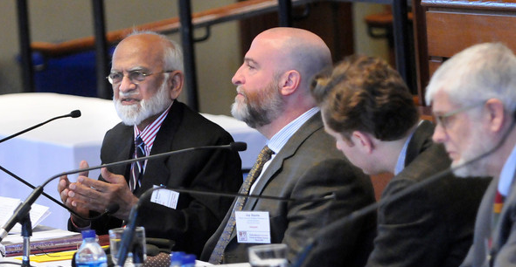
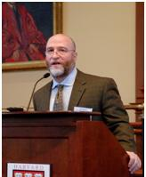
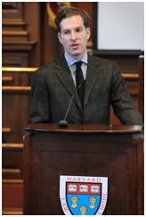
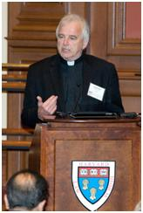

Slide 14
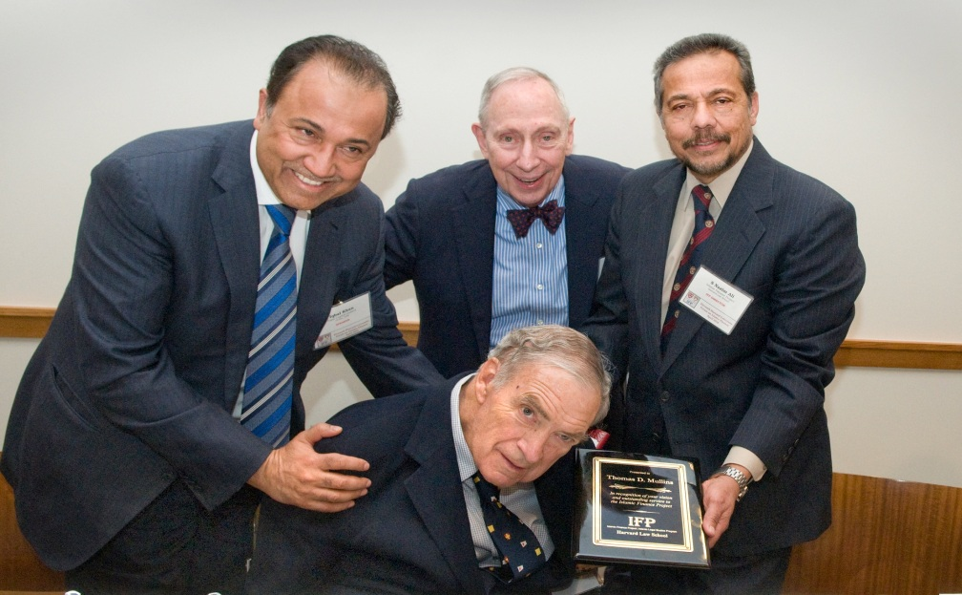
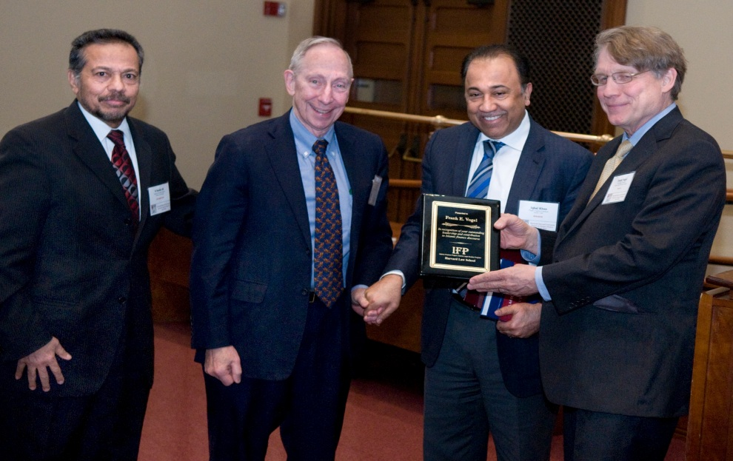
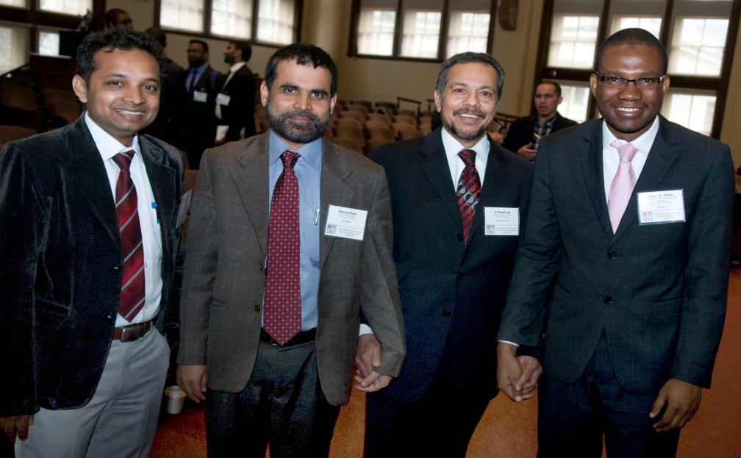
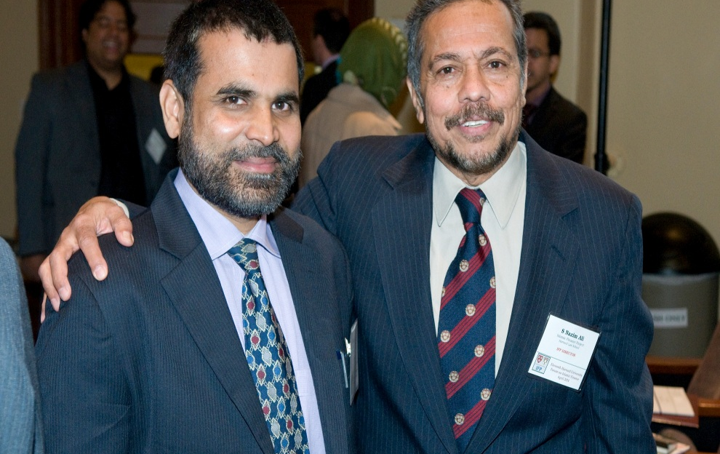

Slide 15

LONDON SCHOOL OF ECONOMICS
Since 2007, IFP has initiated two major activities in collaboration with the London School of Economics (LSE) in London:
Specialized workshops on methodological issues confronting practice. A diverse group of experts participate in the workshop
Public lectures on Islamic finance to attract diverse audience of London School of Economics.
Insert picture/logo
2.

Slide 16
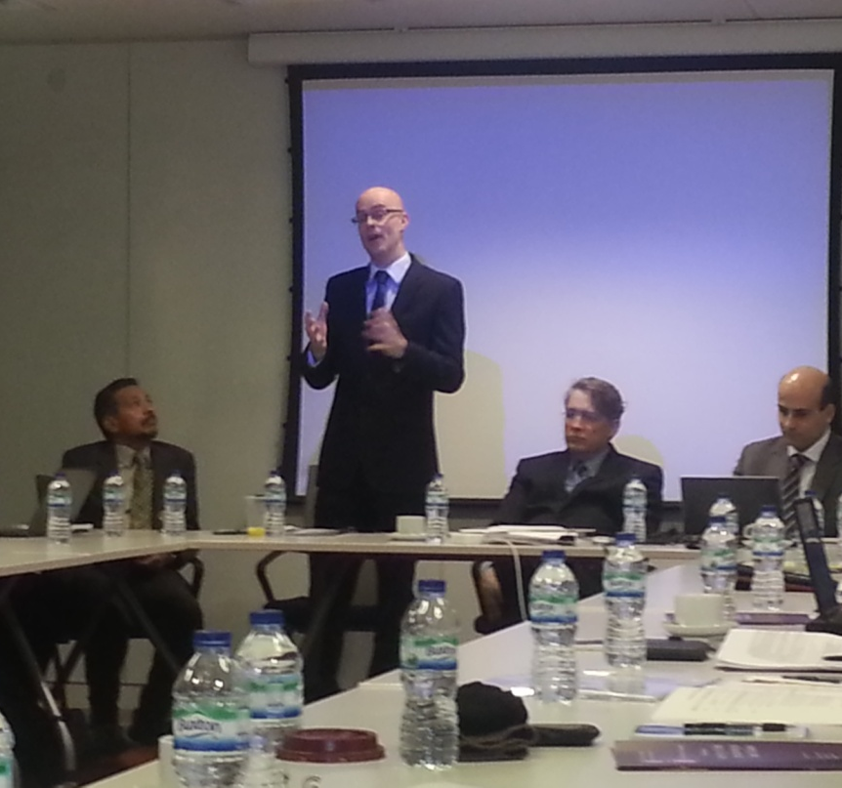
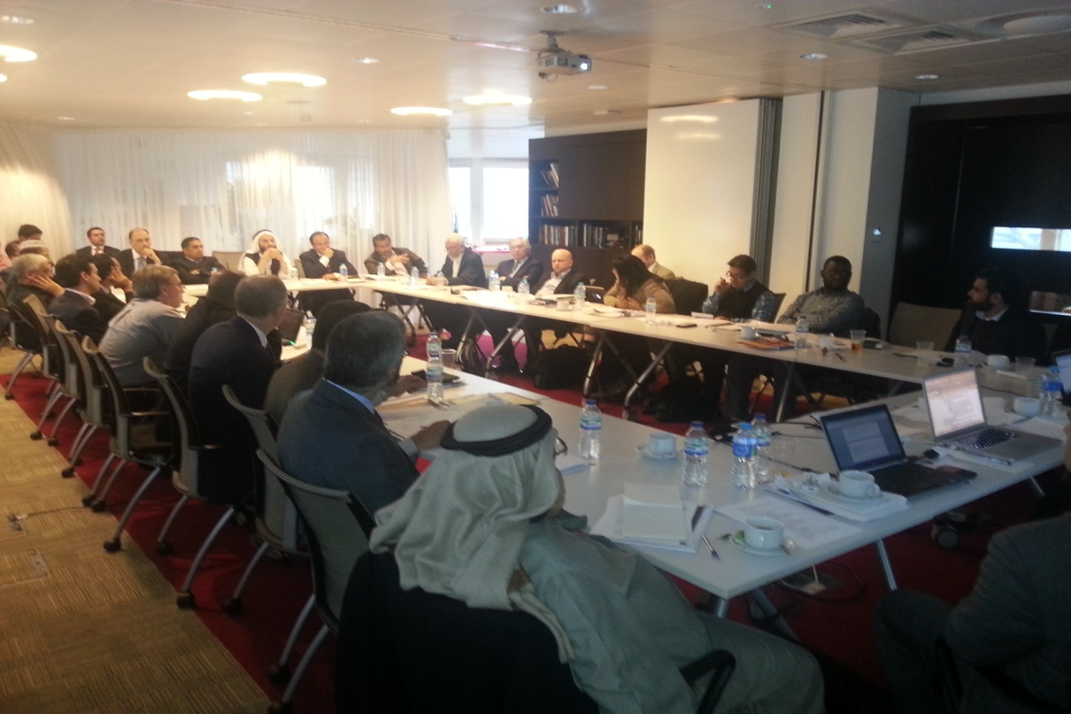
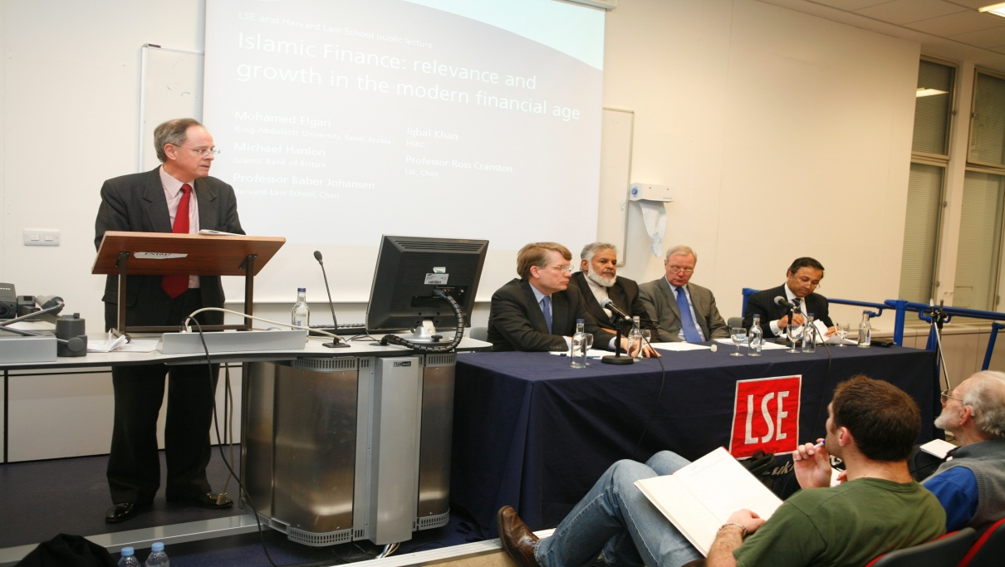
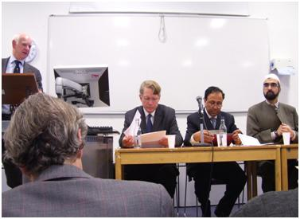
LSE pictures page
Notes:
LSE pictures page

Slide 17
HARVARD-LSE WORKSHOPS
Use and Abuse of Limited Liability
Insolvency and Debt Restructuring
2012 Islamic Financial Intermediation
2010 Reappraising the Islamic Financial Sector
Ethics and Governance
Risk Management
2006 Tawarruq

Slide 18
IFP SPECIALIZED SEMINARS AND PANEL DISCUSSIONS
IFP has organized several specialized seminars and panel discussions to cover topics of strategic importance, in particular economic development in the Muslim world, poverty alleviation, Islamic finance regulation, the global impact of Islamic finance industry, Shari‘a-Compliant mortgages and Islamic finance with regard to bankruptcy and distress. Appendices4 and 5 provide further details of these specialized seminars and panel discussions.

Slide 19
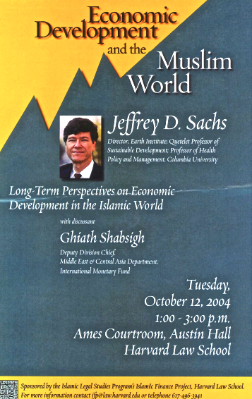
IFP REPORTS AND SPECIAL EVENTS
Events organized by IFP are summarized in the form of short reports for wider dissemination. These all are available on IFP website. Some the reports are listed below for ready reference.
Insolvency and Debt Restructuring in Islamic Finance
The Relevance of Islamic Finance Principles to the Global Financial Crisis
Workshop on Risk Management: Islamic Economic and Ethico-Legal Perspective on Risk Management
Workshop on Sukuk: Economic and Jurisprudential Perspectives
Workshop on Tawarruq
Workshop on Ethical and Methodological Issues in Shari‘a -Compliant Finance
Economic Development and the Muslim World

Slide 20
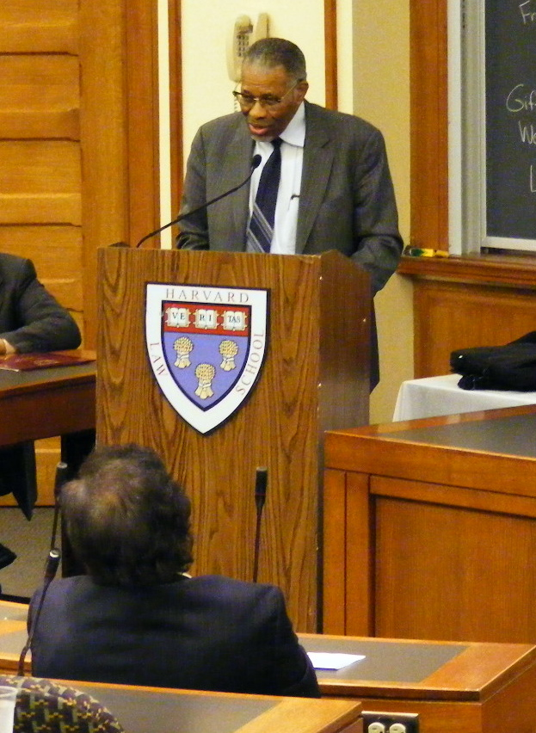
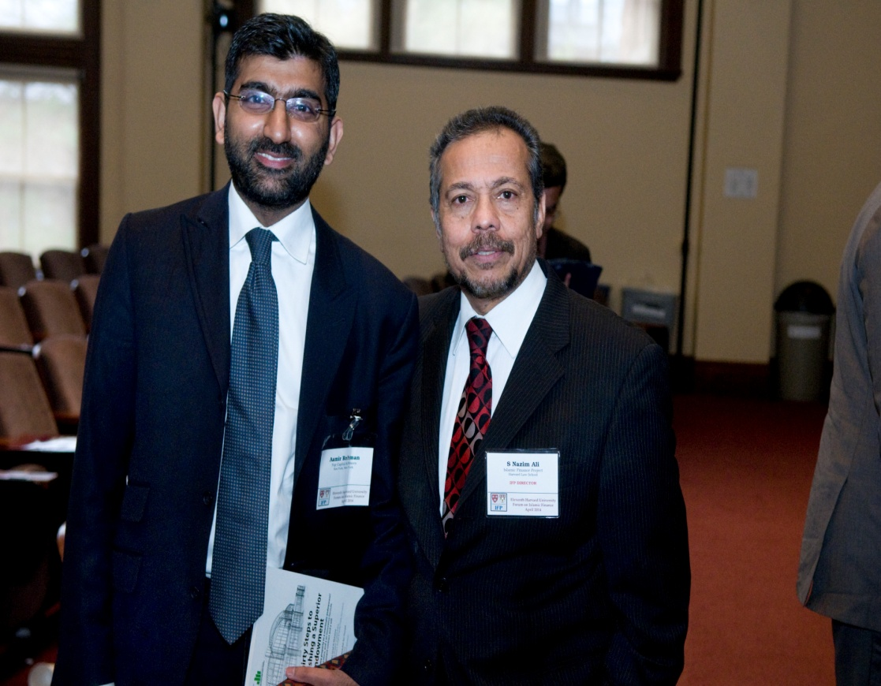
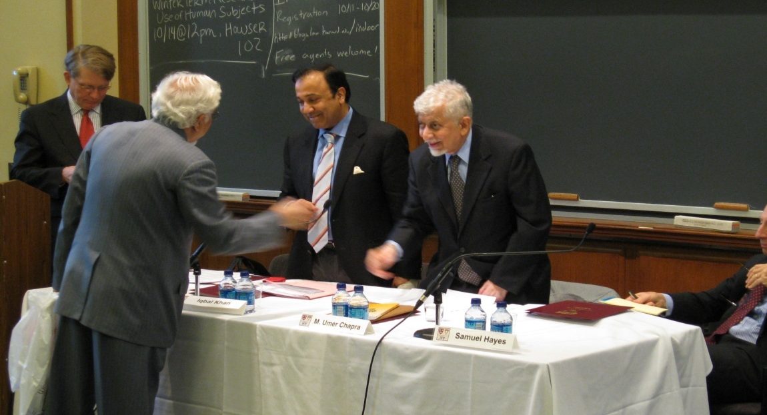
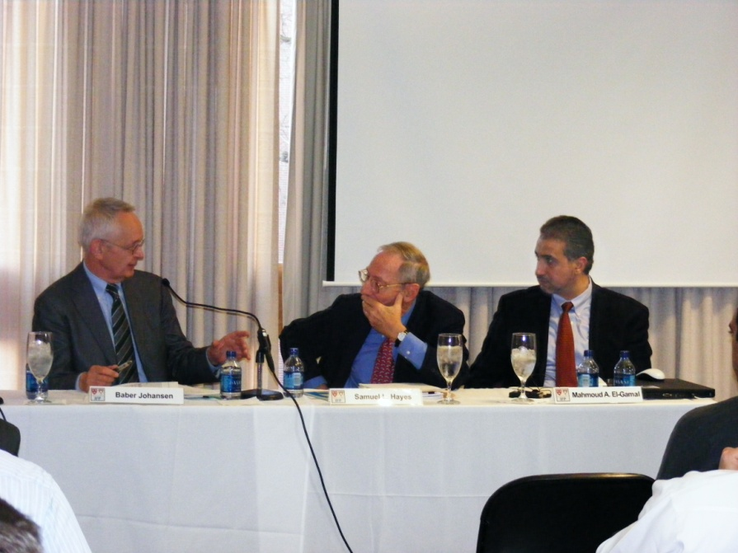

Slide 21
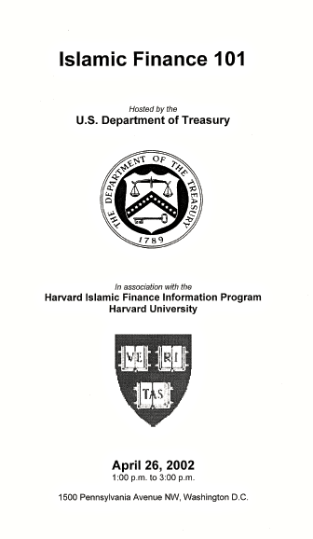
IFP Government Collaboration
As the Islamic finance sector grows, a host of policy issues arise, which governments around the world try to understand. Harvard is home to a unique pool of academic programs, practitioners, and scholars who specialize in public policy, law, and regulation. IFP has harnessed these resources to find pragmatic answers to the questions confronting governments relating to the regulation and growth of the Islamic financial sector.
For example, IFP Director was engaged by the U.S. Treasury to conduct two seminars and a roundtable at the Federal Reserve Bank of New York. IFP regularly communicates with governors of central banks in various countries for creating better understanding of Islamic banking and finance.

Slide 22
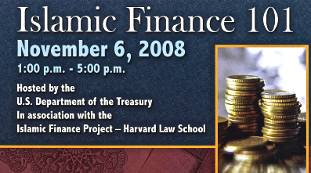
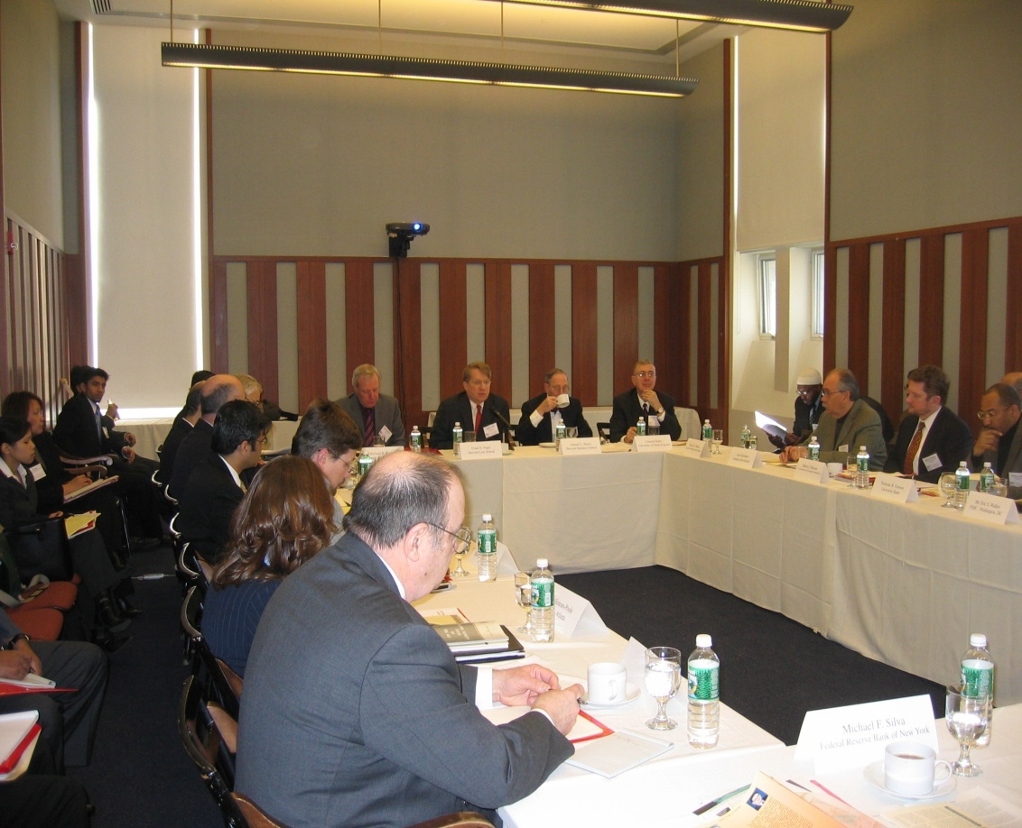
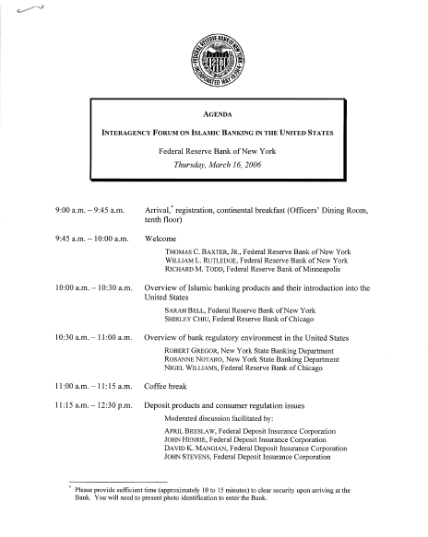
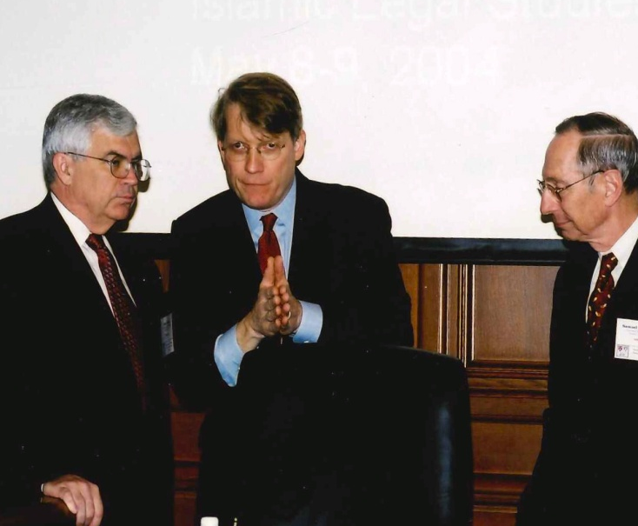
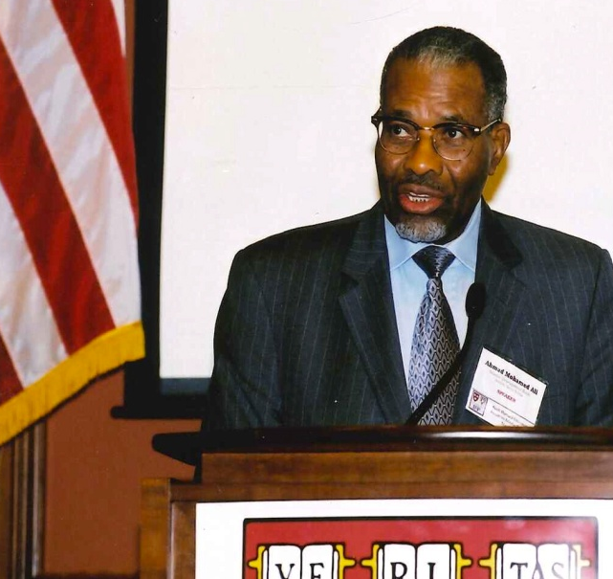
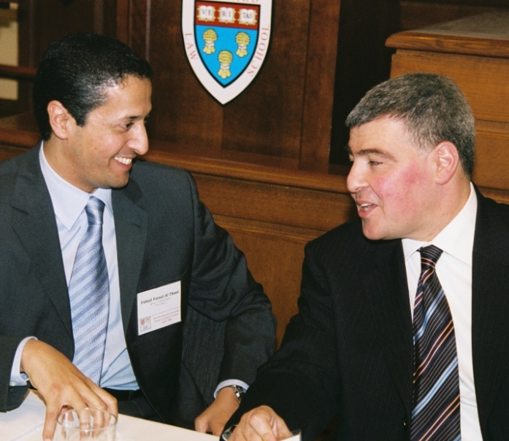

Slide 23
IFP BOOKS
IFP books are curated collectionsof the Forum papers. Students have been the backbone on the success of publishing books. The papers are selected in response to the call for papers from a larger pool of submissions. These papers have been refereed but it must be kept in mind that Islamic banking and finance is relatively a young sector and that its academic content is still evolving, drawing heavily from varied disciplines. However, we have taken care to accommodate papers from either top contemporary academicians of Islamic finance, banking, and economics or top sector experts. A list of IFP’s books follows:
The Tawarruq Debatein Islamic Finance (forthcoming)
Islamic Finance and Development (forthcoming)
Building Bridges across Financial Communities: The Global Financial Crisis, Social Responsibility, and Faith-Based Finance, Cambridge: Massachusetts, Harvard Law School, Islamic Finance Project, 2012, 334p. ISBN 0-9702835-9-8
Islamic Finance: Innovation and Authenticity, Cambridge, Massachusetts: Harvard Law School, Islamic Finance Project, 2010, 320p. ISBN 0-970-2835-7-1
5. Integrating Islamic Finance into the Mainstream: Regulation, Standardization, and Transparency,Cambridge, Massachusetts: Harvard Law School, Islamic Finance Project, 261p. 2007,ISBN 0-9702835-6-3
6. Islamic Finance: Current Legal and Regulatory Issues. Cambridge, Massachusetts: Harvard Law School, Islamic Finance Project, 2005, 222p. ISBN 0-9702835-5-5
7. Shari‘a-Compliant Microfinance, London: Routledge, 2011, 295p. ISBN 978041578266-1

Slide 24
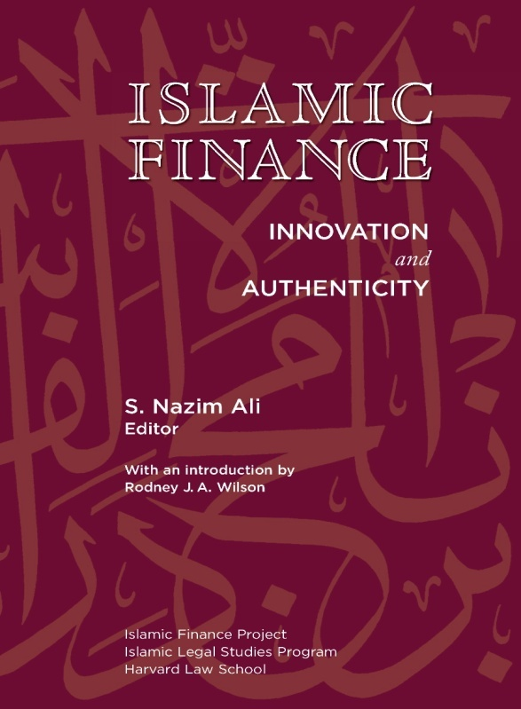
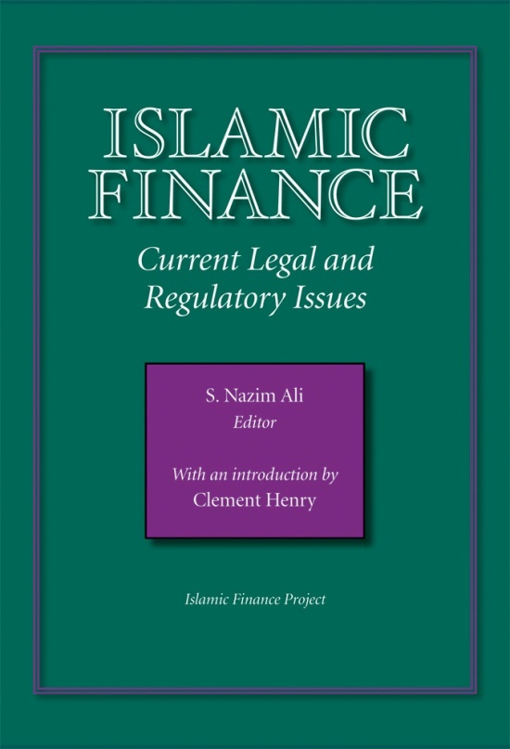



Slide 25
IFP DATABANK
The IFP DataBank was conceived and set up by the Harvard University Centre for Middle Eastern Studies (CMES) in 1995. First produced in CD-ROM in 1997 with several quarterly updates.
In 2003 it was launched on the internet as a totally integrated online information system from acquisition of material, data entry system, editing and an acceptable user interface.
It provides access to over 10,000 records on Islamic economics, finance and other related fields.
It’s objective was:
To a provide one-stop information resource for all material related to Islamic finance.
To acquire, analyze, process, and disseminate the latest information on Islamic finance.

Slide 26





Slide 27
RECONITION DINNER
After nearly 20 years of service to the Harvard Law School community, Dr. Nazim Ali, the Project’s founder and director, will be taking a position as the Qatar Foundation’s newest Professor and Director. To show their appreciation, some of Dr. Ali’s closest friends, pupils, and colleagues gathered to celebrate him at his farewell banquet. Dr. Ali will be dearly missed.

Slide 28










Recognition Dinner and Farewell

